Slide 1
Work and Energy

Slide 2
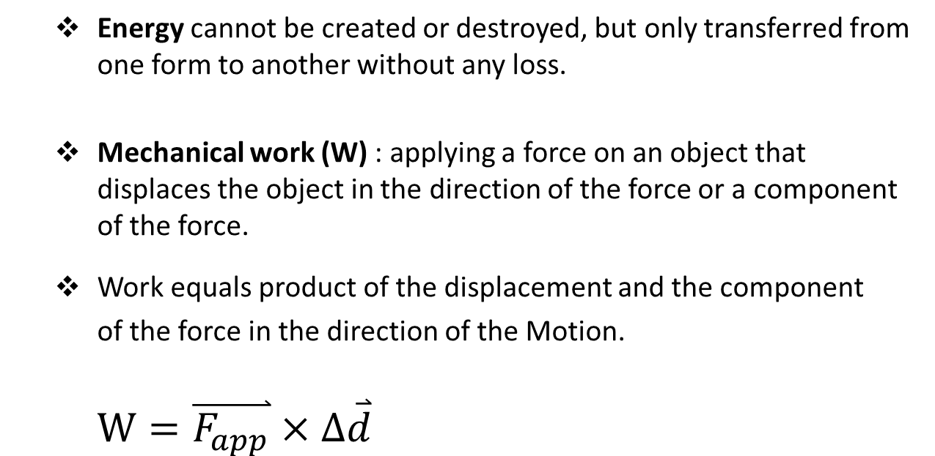
Work, the Transfer of Energy:
Energy cannot be created or destroyed, but only transferred from one form to another without any loss.
Mechanical work (W) : applying a force on an object that displaces the object in the direction of the force or a component of the force.
Work equals product of the displacement and the component
of the force in the direction of the Motion.
$$W=\overset{⃑}{F_{app}}×∆\overset{⃑}{d}$$

Slide 3
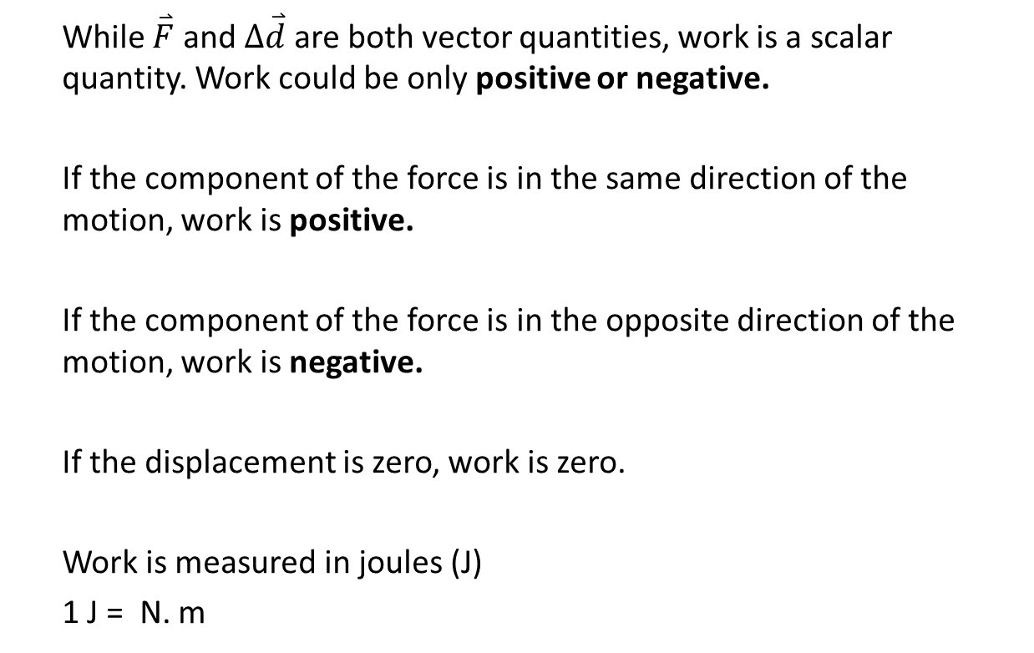
While $\overset{⃑}{F}$ and $∆\overset{⃑}{d}$ are both vector quantities, work is a scalar quantity. Work could be only positive or negative.
If the component of the force is in the same direction of the motion, work is positive.
If the component of the force is in the opposite direction of the motion, work is negative.
If the displacement is zero, work is zero.
Work is measured in joules (J)
1 J = N. m

Slide 4
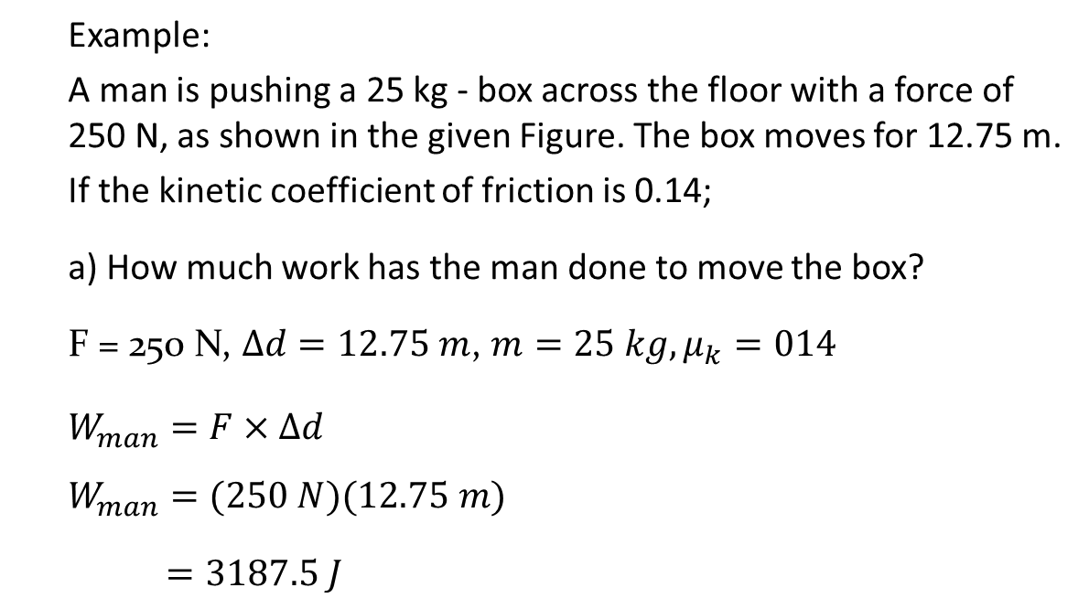
Example:
A man is pushing a 25 kg - box across the floor with a force of 250 N, as shown in the given Figure. The box moves for 12.75 m.
If the kinetic coefficient of friction is 0.14;
a) How much work has the man done to move the box?
F = 250 N, $∆d=12.75 m$, $m=25 kg, μ_{k}=014$
$$W_{man}=F×∆d$$
$$W_{man}=(250 N)(12.75 m)$$
$=3187.5 J$

Slide 5
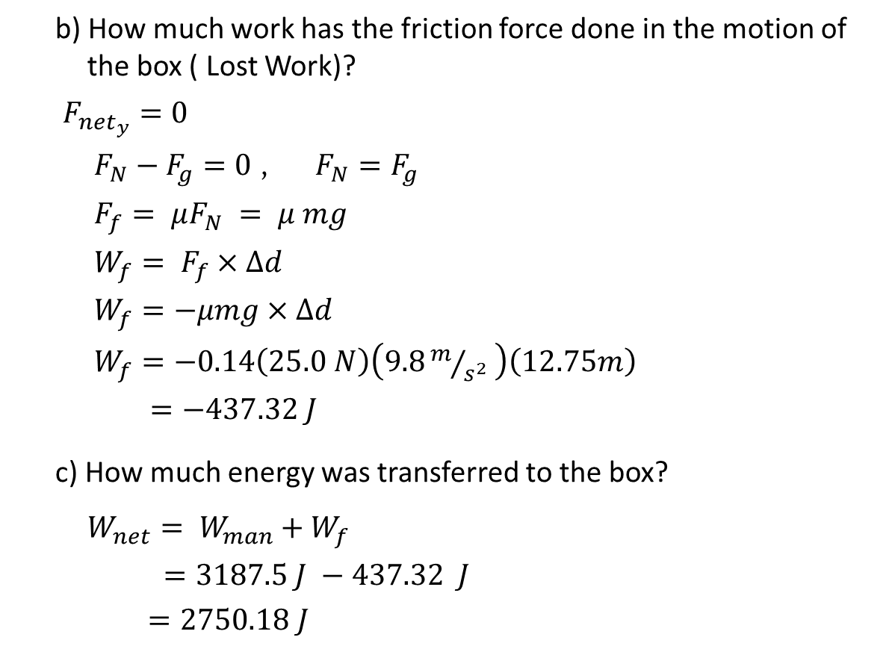
b) How much work has the friction force done in the motion of the box ( Lost Work)?
$F_{{net}_{y}}=0$
$F_{N}−F_{g}=0$ , $F_{N}=F_{g}$
$F_{f}= μF_{N}$ $= μ mg$
$W_{f}= F_{f}×∆d$
$W_{f}=−μmg×∆d$
$W_{f}=−0.14\left(25.0 N\right)\left(9.8m/{s^{2}} \right)\left(12.75m\right)$
$=−437.32 J$
c) How much energy was transferred to the box?
$$W_{net}= W_{man}+W_{f}$$
$=3187.5 J −437.32 J$
$=2750.18 J$

Slide 6
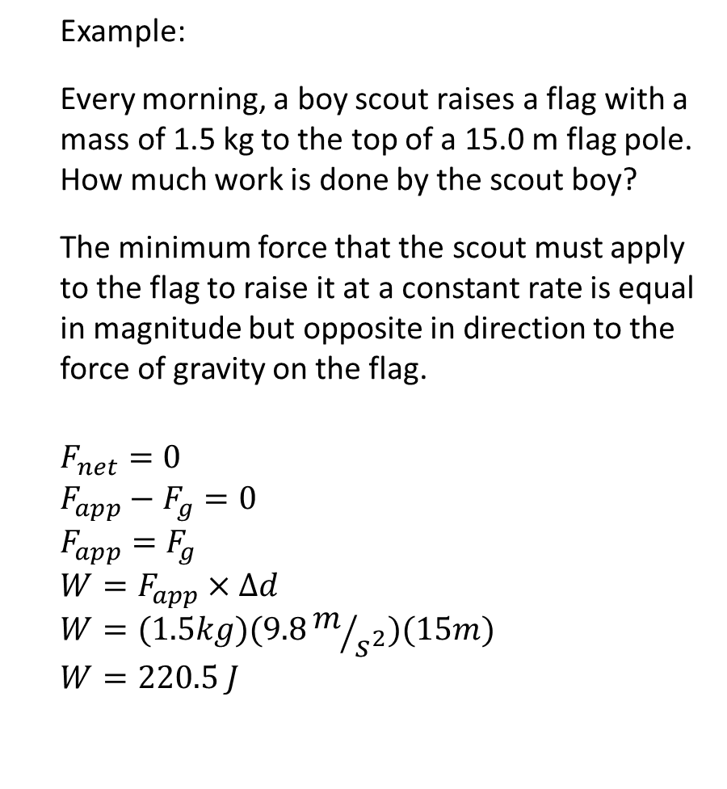
Example:
Every morning, a boy scout raises a flag with a mass of 1.5 kg to the top of a 15.0 m flag pole. How much work is done by the scout boy?
The minimum force that the scout must apply to the flag to raise it at a constant rate is equal in magnitude but opposite in direction to the force of gravity on the flag.
$$F_{net}=0$$
$${F_{app}−F}_{g}=0$$
$$F_{app}=F_{g}$$
$$W=F_{app}×∆d$$
$$W=(1.5kg)(9.8m/{s^{2}})(15m)$$
$$W=220.5 J$$

Slide 7
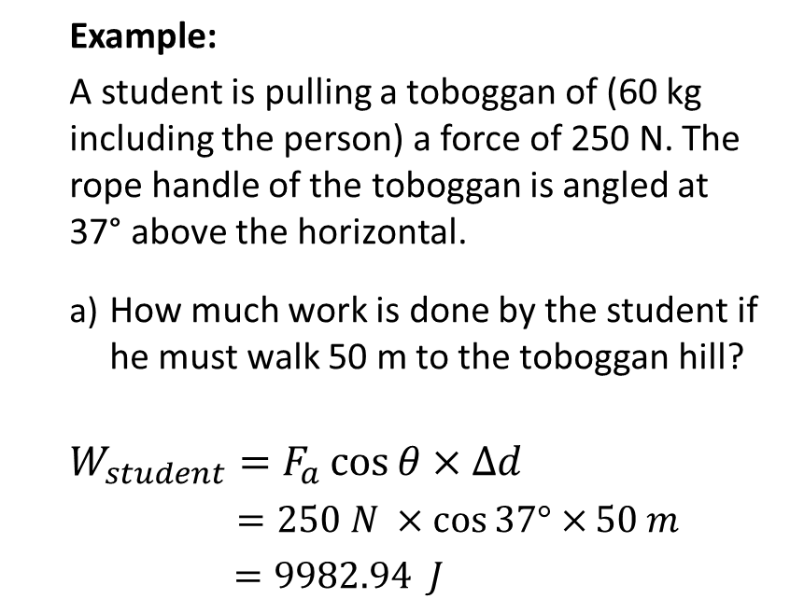
Work done with force at an angle:
Example:
A student is pulling a toboggan of (60 kg including the person) a force of 250 N. The rope handle of the toboggan is angled at 37° above the horizontal.
How much work is done by the student if he must walk 50 m to the toboggan hill?
$$W_{student}=F_{a}\cos{θ×∆d}$$
$=250 N ×\cos{37°×}50 m$
$=9982.94 J$
F= 250 N

Slide 8
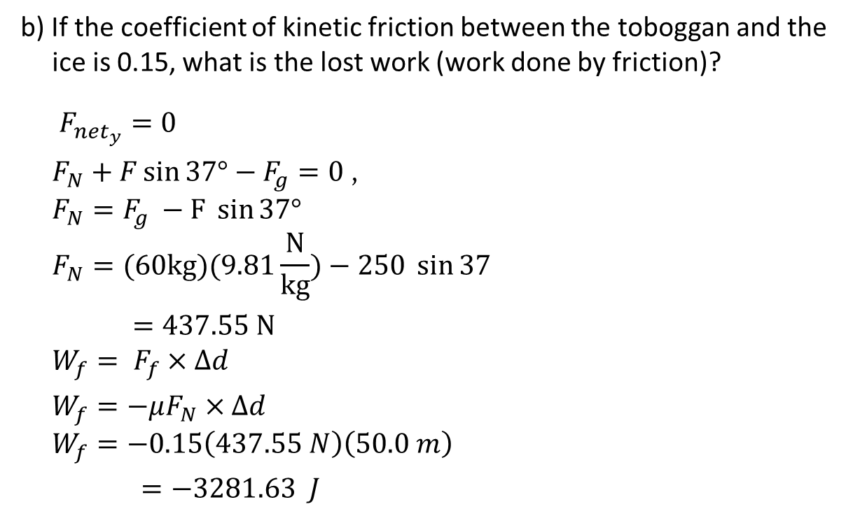
b) If the coefficient of kinetic friction between the toboggan and the ice is 0.15, what is the lost work (work done by friction)?
$F_{{net}_{y}}=0$
$F_{N}+F\sin{37°}−F_{g}=0$ ,
$$F_{N}=F_{g} −F \sin{37°}$$
$$F_{N}=(60kg)(9.81\frac{N}{kg})−250 \sin{37}$$
$=437.55 N$
$$W_{f}= F_{f}×∆d$$
$W_{f}=−μF_{N}×∆d$
$$W_{f}=−0.15\left(437.55 N\right)\left(50.0 m\right)$$
$=−3281.63 J$

Slide 9
Graphing Work Done:
The work done may be represented graphically by plotting the force versus distance graph.
The area between the graph and the x-axis represents the work.
Positive work is represented above the d-axis.
Negative work is represented below the d-axis.

Slide 10
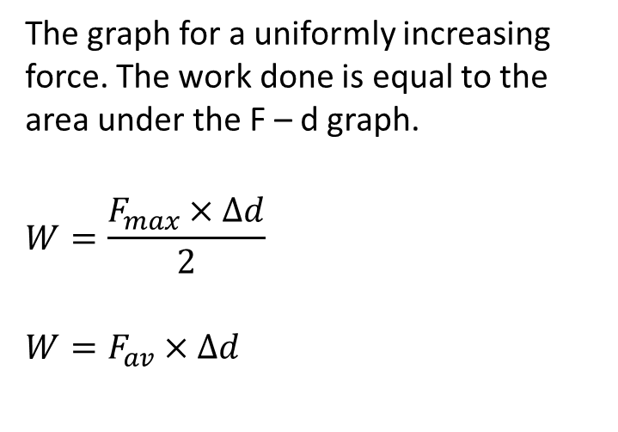
Work Done by a Changing Force
The graph for a uniformly increasing force. The work done is equal to the area under the F – d graph.
$$W=\frac{F_{max}×∆d}{2}$$
$$W=F_{av}×∆d$$

Slide 11
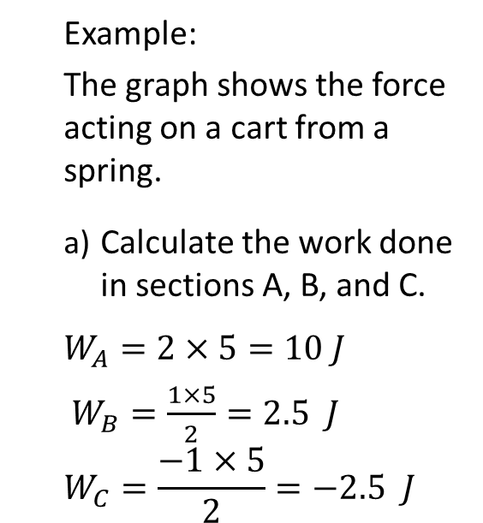
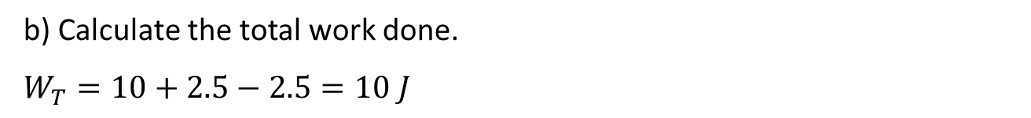
Example:
The graph shows the force acting on a cart from a spring.
Calculate the work done in sections A, B, and C.
$$W_{A}=2×5=10 J$$
$W_{B}=\frac{1×5}{2}=2.5 J$
$$W_{C}=\frac{−1×5}{2}=−2.5 J$$
b) Calculate the total work done.
$$W_{T}=10+2.5−2.5=10 J$$

Slide 12
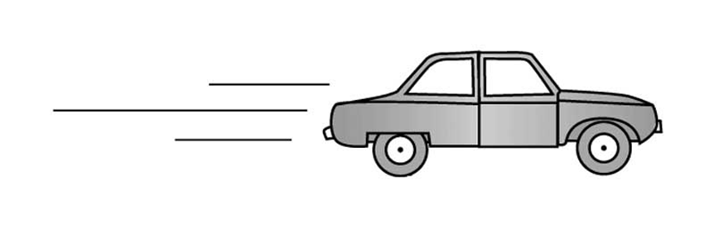
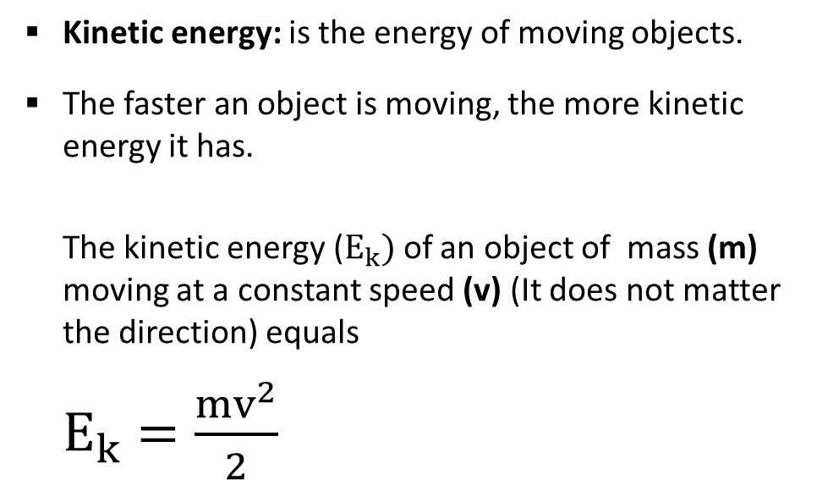
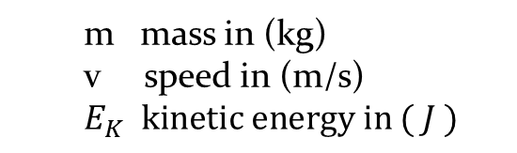
Kinetic Energy:
Kinetic energy: is the energy of moving objects.
The faster an object is moving, the more kinetic energy it has.
The kinetic energy ($E_{k})$of an object of mass (m) moving at a constant speed (v) (It does not matter the direction) equals
$E_{k}=\frac{mv^{2}}{2}$
m mass in (kg)
v speed in (m/s)
$E_{K} kinetic energy in ( J )$

Slide 13
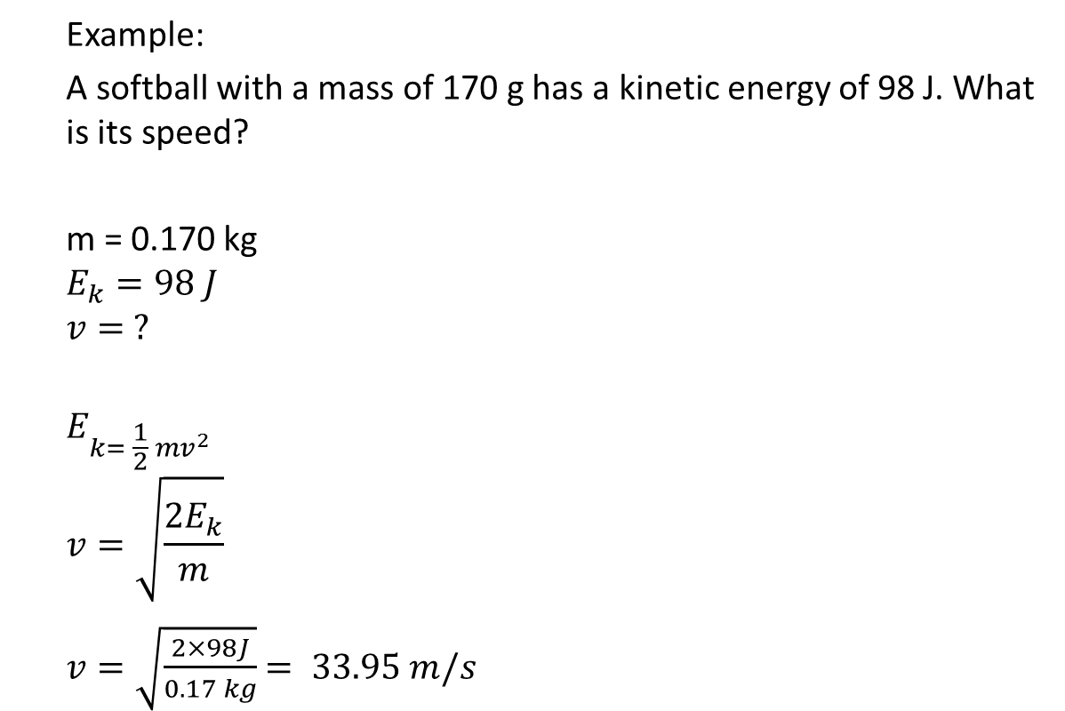
Example:
A softball with a mass of 170 g has a kinetic energy of 98 J. What is its speed?
m = 0.170 kg
$$E_{k}=98 J$$
$$v= ?$$
$$E_{k= \frac{1}{2} mv^{2}}$$
$$v=\sqrt{\frac{2E_{k}}{m}}$$
$v=\sqrt{\frac{2×98J}{0.17 kg}}$ $= 33.95 m/s$

Slide 14
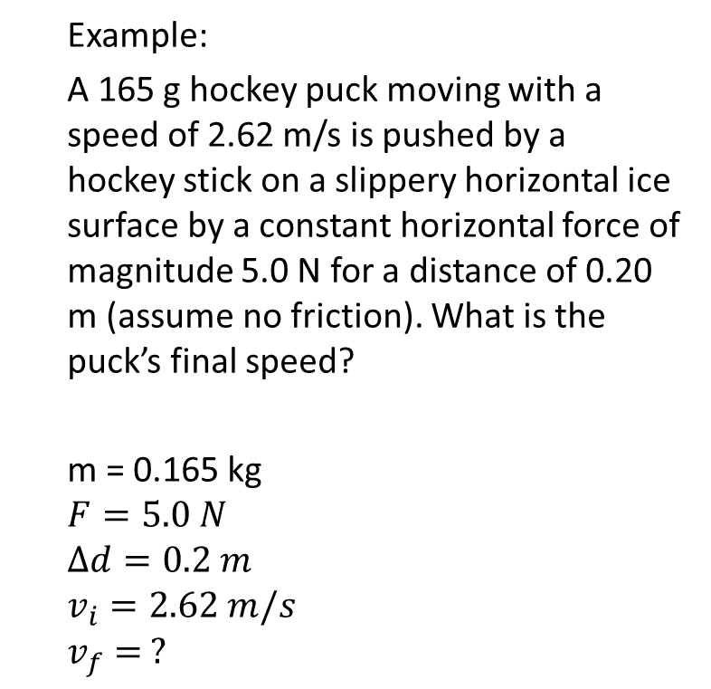
Example:
A 165 g hockey puck moving with a speed of 2.62 m/s is pushed by a hockey stick on a slippery horizontal ice surface by a constant horizontal force of magnitude 5.0 N for a distance of 0.20 m (assume no friction). What is the puck’s final speed?
m = 0.165 kg
$$F=5.0 N$$
$$∆d=0.2 m$$
$$v_{i}=2.62 m/s$$
$$v_{f}= ?$$

Slide 15
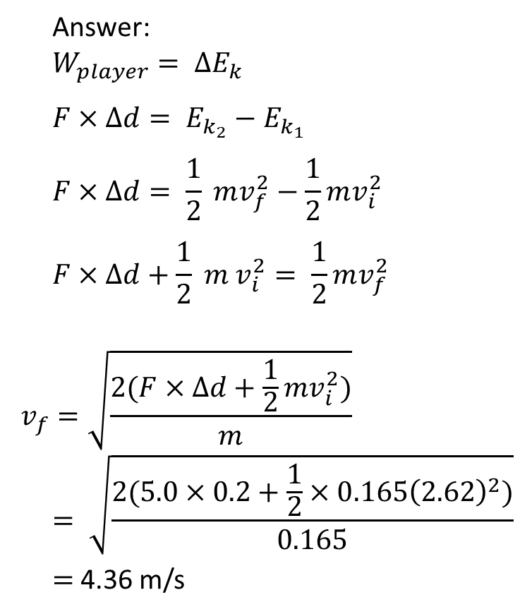
Answer:
$$W_{player}= ∆E_{k}$$
$$F×∆d= E_{k_{2}}−E_{k_{1}}$$
$$F×∆d= \frac{1}{2} mv_{f}^{2}−\frac{1}{2}mv_{i}^{2}$$
$$F×∆d+\frac{1}{2} m v_{i}^{2}= \frac{1}{2}mv_{f}^{2}$$
$$v_{f}=\sqrt{\frac{2(F×∆d+\frac{1}{2}mv_{i}^{2})}{m}}$$
$$= \sqrt{\frac{2(5.0×0.2+\frac{1}{2}×0.165{\left(2.62\right)}^{2})}{0.165}}$$
$=$ 4.36 m/s

Slide 16

Potential energy: is energy that is stored or energy and not actually in use at the present moment.
Gravitational Potential Energy: is the energy stored in an object due to its height in a gravitational field where the force of gravity can act on it to make it fall.

Slide 17
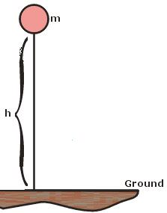
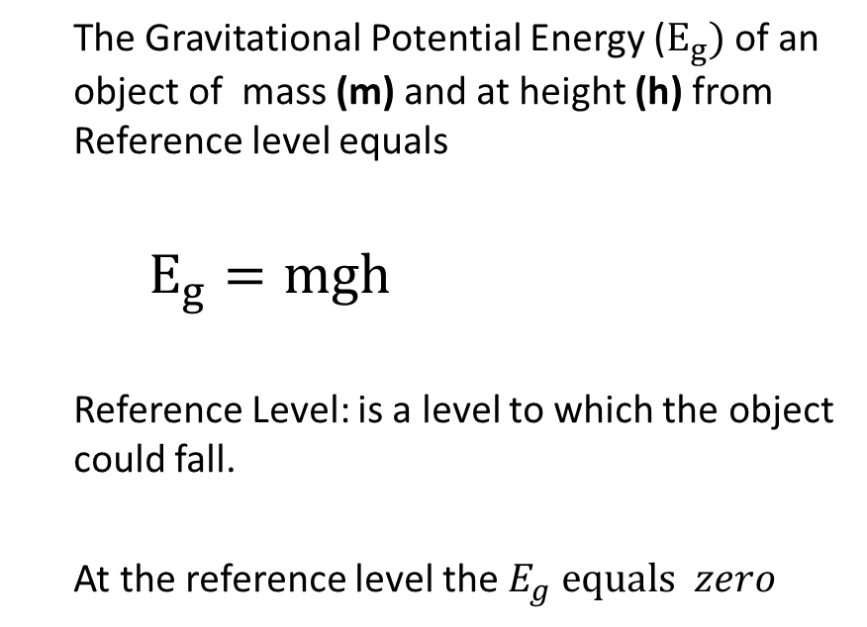
Gravitational Potential Energy:
The Gravitational Potential Energy ($E_{g})$of an object of mass (m) and at height (h) from Reference level equals
$E_{g}=mgh$
Reference Level: is a level to which the object could fall.
At the reference level the $E_{g} equals zero$

Slide 18
Example:
A 58 kg person walks down the flight of stairs shown in the given Figure. Use the ground as
the reference level. T/I
(a) Calculate the person’s gravitational potential energy at the top of the stairs, on the landing, and at ground level.
(b) What happens to gravitational potential energy as you go down a flight of stairs?
(c) What happens to gravitational potential energy as you climb a flight of stairs?

Slide 19
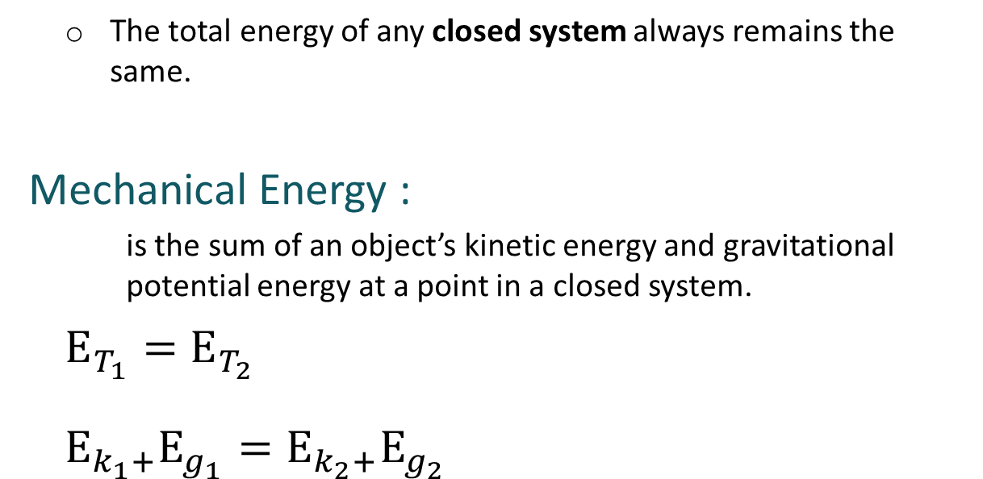
Conservation of energy in a Closed System
The total energy of any closed system always remains the same.
Mechanical Energy :
is the sum of an object’s kinetic energy and gravitational potential energy at a point in a closed system.
$E_{T_{1}}=$ $E_{T_{2}}$
$$E_{k_{1}+}E_{g_{1}}=E_{k_{2}+}E_{g_{2}}$$

Slide 20

MECHANICAL ENERGY
Mechanical Energy is the sum of an object’s kinetic energy and gravitational potential energy.
$$E_{T}=E_{k}+E_{g}$$
$E_{T_{1}}=$ $E_{T_{2}}$
$$E_{k_{1}+}E_{g_{1}}=E_{k_{2}+}E_{g_{2}}$$

Slide 21
Example:
A 1.1 kg camera slips out of a photographer’s hands while he
is taking a photograph. The camera falls 1.4 m to the ground
below.
(a) What is the camera’s gravitational potential energy relative to the ground when it is in the photographer’s hands?
(b) Using the law of conservation of energy, determine the camera’s kinetic energy at the instant before it hits the ground.
(c) Use the camera’s kinetic energy to determine its speed at the instant it hits the ground.

Slide 22
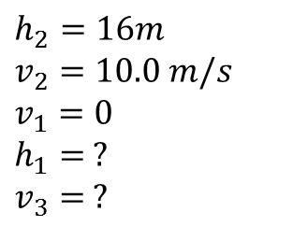

Example:
For safety reason, the roller coasters must have a minimum speed of 10.0 m/s at the top of the loop to make it safe at the top of the loop. Assuming that the roller coaster starts from rest at the top of the first hill and there is no friction on the roller coaster;
What is the minimum height of the first hill?
1
2
$$h_{1}$$
3
$$h_{2}=16m$$
$$v_{2}=10.0 m/s$$
$$v_{1}=0$$
$$h_{1}= ?$$
$$v_{3}= ?$$

Slide 23
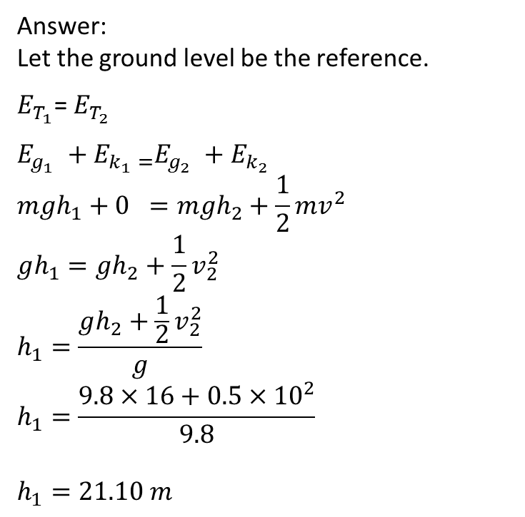
Answer:
Let the ground level be the reference.
$E_{T_{1}}$= $E_{T_{2}}$
$$E_{g_{1} }+E_{k_{1} \text{=}}E_{g_{2} }+E_{k_{2} }$$
$$mgh_{1}+0 =mgh_{2}+\frac{1}{2}mv^{2}$$
$$gh_{1}=gh_{2}+\frac{1}{2}v_{2}^{2}$$
$$h_{1}=\frac{gh_{2}+\frac{1}{2}v_{2}^{2}}{g}$$
$$h_{1}=\frac{9.8×16+0.5×{10}^{2}}{9.8}$$
$$h_{1}=21.10 m$$
1
2
$$h_{1}$$
3

Slide 24
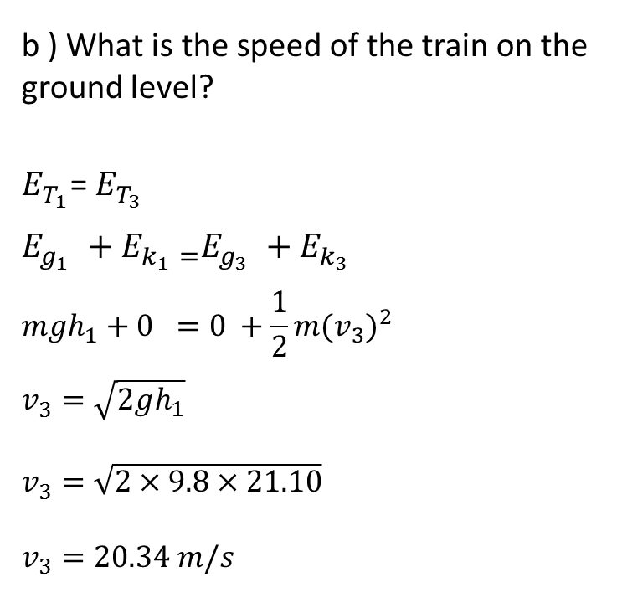
b ) What is the speed of the train on the ground level?
$E_{T_{1}}$= $E_{T_{3}}$
$$E_{g_{1} }+E_{k_{1} \text{=}}E_{g_{3} }+E_{k_{3} }$$
$$mgh_{1}+0 =0 +\frac{1}{2}m{(v_{3})}^{2}$$
$$v_{3}^{}=\sqrt{2gh_{1}}$$
$$v_{3}^{}=\sqrt{2×9.8×21.10}$$
$$v_{3}=20.34 m/s$$
1
2
$$h_{1}$$
3

Slide 25
Example:
A 156 kg diver jumps off the end of a 7.5 m platform with an initial horizontal speed of 1.6 m/s.
Apply the law of conservation of energy to determine the diver’s speed at a height of 2.8 m above the water.
Find the maximum speed of the diver upon reaching the water.

Slide 26
Example:
A 0.20 kg ball is thrown straight up from the edge of a 30.0 m tall building at a velocity of 22.0 m/s [Up]. The ball moves up to the maximum height and then falls to the ground at the base of the building.
Use the law of conservation of energy to find the maximum height of the ball?
What is the velocity of the ball when it hits the ground?

Slide 27

Example:
A 2.0-kg bag is held by a string to the ceiling. The length of the string and the bag is 80 cm. The bag is held stationary in in the lowest position then it is pushed horizontally to have a speed of 1.6 m/s moving freely as a pendulum. Assuming there is no friction, determine:
a) the maximum height " h" of the bag above the lowest point.
The angle that the string makes with the vertical when it is at the maximum height.
Mechanical Energy Conservation
$$θ$$
L
m
m
h
https://www.youtube.com/watch?v=mhIOylZMg6Q

Slide 28
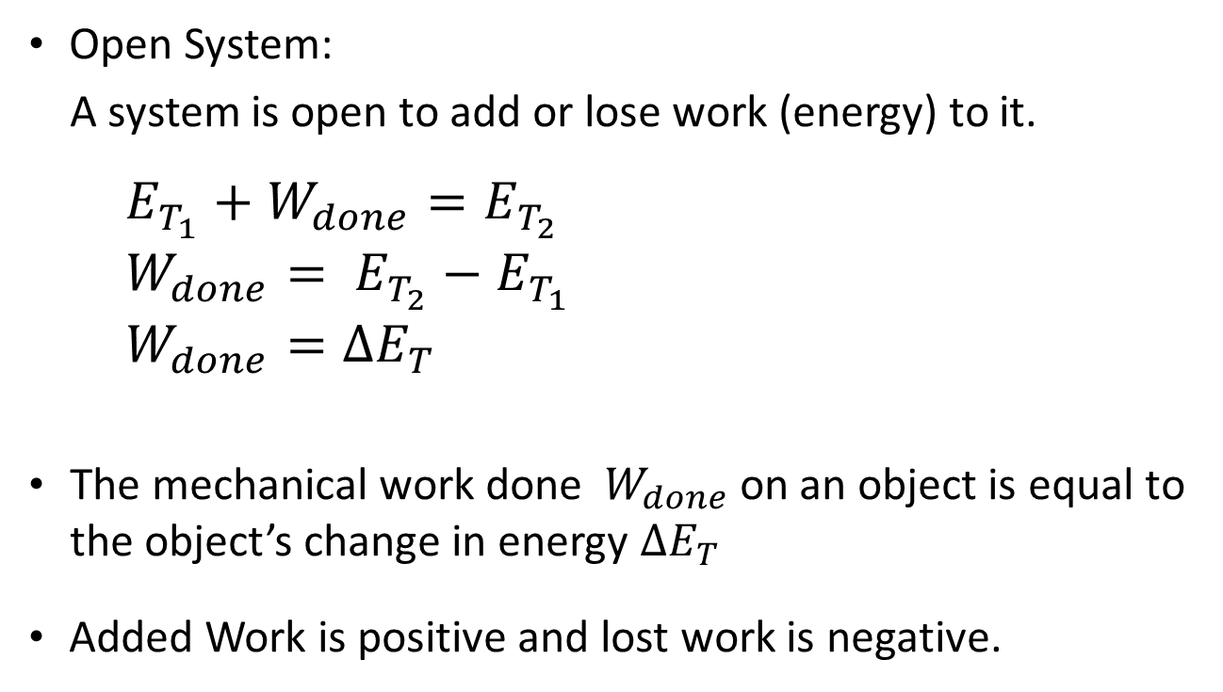
Conservation of Energy in an Open System
Open System:
A system is open to add or lose work (energy) to it.
$${E_{T_{1}}+W}_{done}=E_{T_{2}}$$
$$W_{done}= E_{T_{2}}−E_{T_{1}}$$
$$W_{done}=∆E_{T}$$
The mechanical work done $W_{done}$ on an object is equal to the object’s change in energy $∆E_{T}$
Added Work is positive and lost work is negative.

Slide 29
Example:
A 13 kg object travelling at 10 m/s accelerates to a speed of 14 m/s
over a displacement of 8.2 m. No friction.
Calculate the net work done on the car.
Calculate the net force acting on the car.

Slide 30
Example:
A 1250 kg car is travelling at 100 km/h when the driver puts on the brakes to slow down its speed to 50 km/h in a distance of 300 m. What was the average frictional force that caused the car to slow down?

Slide 31
Example:
A 1000-kg car is moving at 13 m/s when it comes to an upward sloping ramp. The upward ramp is 125m long and height of 5 m:
With no friction, what is the speed of the car on the top of the ramp?
With friction, the car could reach the top of the ramp and stop on it, what is the magnitude of the friction force?
Questions # 41 – 44 on page 243 of the package and Questions # 1 – 4 on page 241 of the textbook

Slide 32
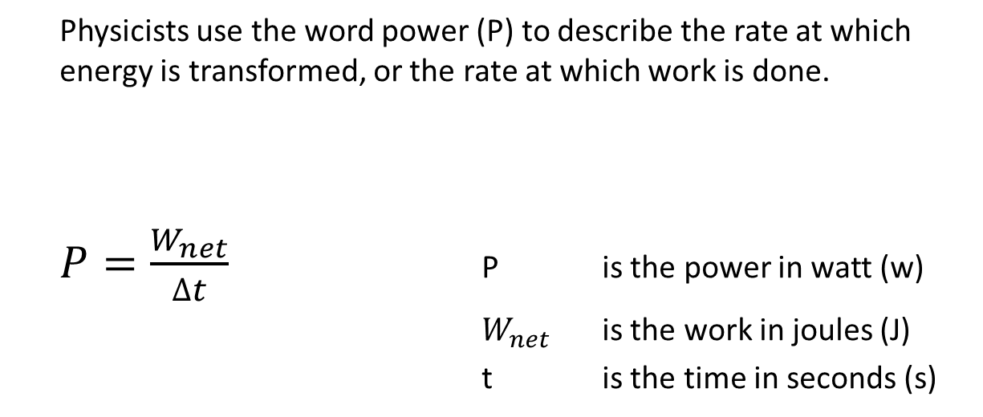
Power
Physicists use the word power (P) to describe the rate at which energy is transformed, or the rate at which work is done.
$P=\frac{W_{net}}{∆t}$ P is the power in watt (w)
$W_{net}$ is the work in joules (J)
t is the time in seconds (s)

Slide 33
Example:
A 64 kg student climbs from the ground floor to the second floor of his
school in 5.5 s. The second floor is 3.7 m above the ground floor.
What is the student’s power?

Slide 34
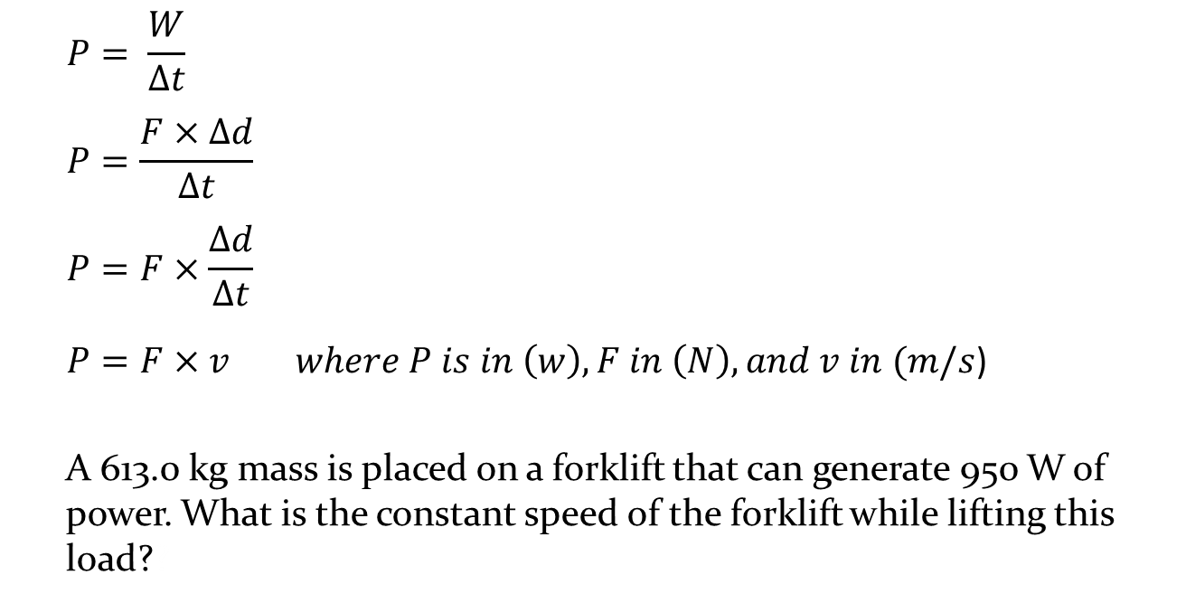
Power
$$P= \frac{W}{∆t}$$
$$P=\frac{F×∆d}{∆t}$$
$$P=F×\frac{∆d}{∆t}$$
$P=F×v where P is in \left(w\right), F in \left(N\right), and v in (m/s$)
A 613.0 kg mass is placed on a forklift that can generate 950 W of power. What is the constant speed of the forklift while lifting this load??

Slide 35
Example:
A 613.0 kg mass is placed on a forklift that can generate 950 W of power. What is the constant speed of the forklift while lifting this load??

Slide 36
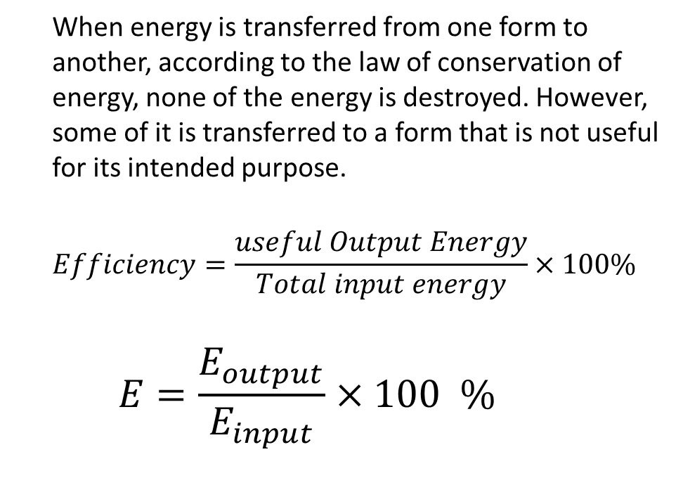
Efficiency of Energy Transfer Processes
When energy is transferred from one form to another, according to the law of conservation of energy, none of the energy is destroyed. However, some of it is transferred to a form that is not useful for its intended purpose.
$$Efficiency=\frac{useful Output Energy}{Total input energy}×100\%$$
$$E=\frac{E_{output}}{E_{input}}×100 \%$$

Slide 37
Example:
What is the efficiency of a rope-and-pulley system if a painter uses 1.93 kJ of mechanical energy to pull on the rope and lift a 20.0 kg paint barrel to a height of 7.5 m above the ground?

Slide 38
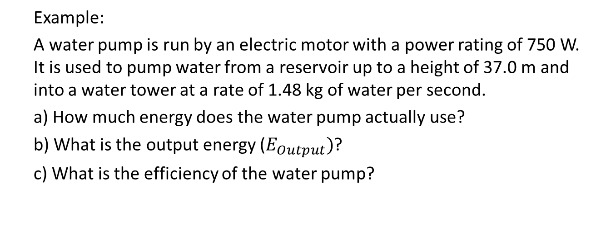
Example:
A water pump is run by an electric motor with a power rating of 750 W. It is used to pump water from a reservoir up to a height of 37.0 m and into a water tower at a rate of 1.48 kg of water per second.
a) How much energy does the water pump actually use?
b) What is the output energy ($E_{Output})$?
c) What is the efficiency of the water pump?

Slide 39
Example:
The Pickering Nuclear power plant has a power rating of 3100 MW.
How much output energy can the generating station produce in one day? Express your answer in MJ.
If the power plant is 38% efficient, how much input energy is required?
How much energy, in MJ, is lost during one day’s operation?
Questions # 45 – 47 on page 244 of the package and
Questions # 1 – 5 on p. 254 of the textbook

